Slide 1

Tribhuvan University
Butwal Multiple Campus
Introduction to Information Technology
TOPIC :-
Database Management System
@ Ayush Khatri
PRESENTING BY :
@ Binod Kandel
@ Bishal Bhattrai
@ Ritesh Pokhrel

Slide 2
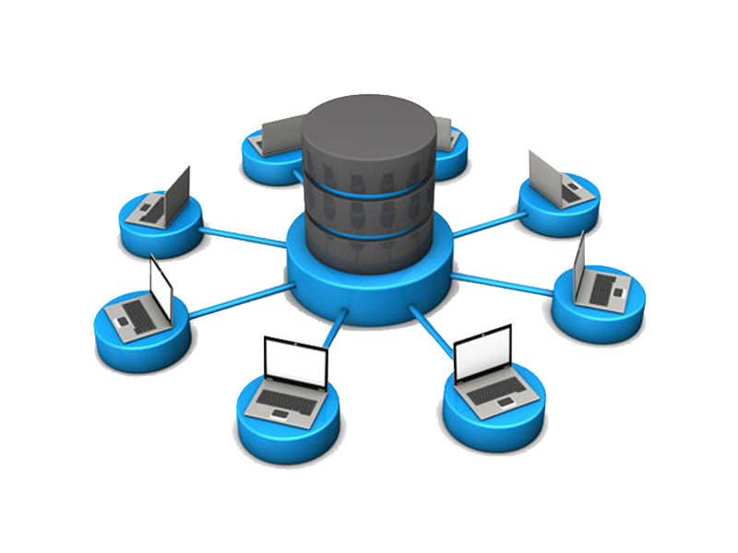
Introduction
DBMS stands for Database Management System.
DBMS is form by Database and Management System where as database means Collection of related data stored electronically in systematic Manner and management system means set of program to store and retrieve those data(present in database).
DBMS is a collection of data and set of program to access and store those data in an easy and efficient manner. DBMS is a software which is used to manage database.
DBMS allow the to modify the database.
Source:- www.targetech.com

Slide 3
ELEMENT
1) Storage engine
The storage engine is the core component of the DBMS that interacts with the file system at an OS level to store data. All SQL queries which interact with the underlying data go through the storage engine.
2) Log manager
This component will keep all the logs of the DBMS. These logs will consist of user logins and activity, database functions, backups and restore functions, etc. The log manager ensures all these logs are properly recorded and easily accessible.
3) Reporting & monitoring tool
Reporting and monitoring tools are another standard component that comes with a DBMS. Reporting tools will enable users to generate reports while monitoring tools enable monitoring the databases for resource consumption, user activity, etc.
4) Query processor
This is the intermediary between the user queries and the database. The query processor interprets the queries of users and makes them actionable commands that can be understood by the database to perform the appropriate functionality.
SOURCE:- www.bmcsoftware.com

Slide 4
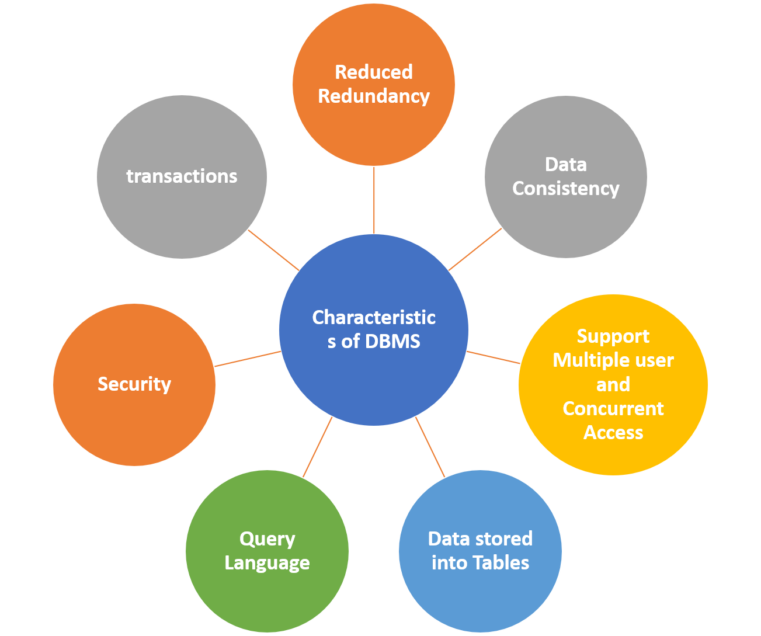
CHARACTERISTICS
1) Real World Entity
The DBMS is designed in such a way that it can cater to the needs of huge business organizations and can store large data with efficient operations on them. Database can store things like cost of vegetables or cost of different brands of breads etc.
2) Stores Any Kind of Structured Data
DBMS can store practically any data that exists in the world and is
structured and this is yet another very important characteristic because we need to work on every kind of data present.
3) Security
The access to make changes to a database by the user is limited and the users not able to access entire database.
4) Ease of access
we can run a search query to find any data and the process is way faster then manual searching and is more reliable
Source:- www.interviewbit.com

Slide 5
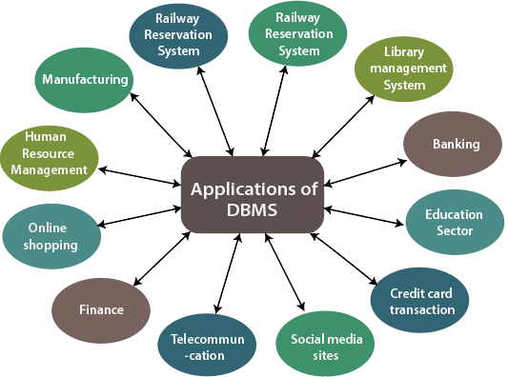
APPLICATION
1) Health Care
In healthcare industry, DBMS is used to store and manage patient records, medical histories, test results, and other health related data.
2) Railways And Airlines
Records related to ticket booking, arrival time, departure time, delays, and seat numbers of airplanes and trains can be done by using DBMS.
3) Banking
Thousands of new bank accounts, transactions and deposits are made on a daily basis through DBMS that keeps track of all the records in an efficient way.
4) Education
In education sector, DBMS is used to manage and organize student data, course details, library resources and activities that provides information in a well-mannered form.
SOURCE:- www.tutuorialandexample.com

Slide 6
THANK YOU

